Slide 1
Predictive Maintenance

Slide 2
Problem Statement
AGENDA
Machine learning pipeline
Well-architected framework

Slide 3
Introduction to maintenance
Problem definition
Problem Statement
Desired outcome and success metrics
Challenges and constraints
Is this a machine learning problem?

Slide 4

Introduction to maintenance
What Is Machine Maintenance?

Slide 5
Introduction to maintenance
What Is Machine Maintenance?
Machine maintenance refers to the tasks and activities performed to keep mechanical equipment in good working condition. This includes regular inspections, cleaning, lubricating, replacing worn parts, making adjustments, and performing repairs

Slide 6
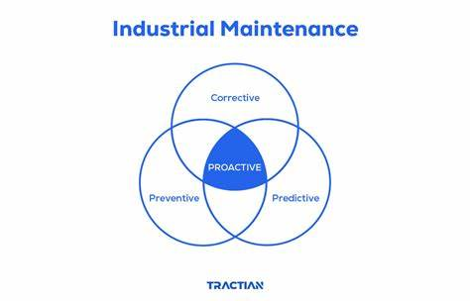
Introduction to maintenance
Types of maintenance:
Corrective maintenance
Repairs are made after a machine has already failed
Preventive maintenance
Regularly scheduled tasks to prevent failures, such as inspections and part replacements

Slide 7
Introduction to maintenance
Types of maintenance:
Predictive maintenance
Uses real-time data and analytics to predict when maintenance should be performed to prevent failures
Proactive maintenance
The utilization of all previous types to maximize the benefits

Slide 8
Introduction to maintenance
Problem definition
Problem Statement
Desired outcome and success metrics
Challenges and constraints
Is this a machine learning problem?

Slide 9
Problem definition
Predictive maintenance: It is needed to predict whether the machine is going to failure or no, to:
Reduce the cost of machine repairing
Minimize downtime
Increase machine life-time (decrease deprecation cost)
Stakeholders: all investors in industry and engineers who works in an industrial field

Slide 10
Introduction to maintenance
Problem definition
Problem Statement
Desired outcome and success metrics
Challenges and constraints
Is this a machine learning problem?

Slide 11
Desired outcome and success metrics
Reduce the time interval between preventive maintenance
Reduce the cost of sudden failure
Minimize down time.
Success metric: correctly identify more than 50% of sudden failures before it happens

Slide 12
Introduction to maintenance
Problem definition
Problem Statement
Desired outcome and success metrics
Challenges and constraints
Is this a machine learning problem?

Slide 13
Challenges and constraints
The data is highly imbalanced (much more negative readings than positive readings)
Non-uniform data structure from different sources
High data confidentiality (companies often don’t provide the data needed to train models)

Slide 14
Introduction to maintenance
Problem definition
Problem Statement
Desired outcome and success metrics
Challenges and constraints
Is this a machine learning problem?

Slide 15
Is this a machine learning problem
Different machine learning models have high potential to identify the complex behavior of machines and capture the relative patterns.
In the other hand, Functional programming and human thanking can’t capture such patterns.

Slide 16
Introduction to maintenance
Problem definition
Problem Statement
Desired outcome and success metrics
Challenges and constraints
Is this a machine learning problem?

Slide 17
Problem Statement
AGENDA
Machine learning pipeline
Well-architected framework

Slide 18
Machine learning pipeline
New data or re-training
Model deployment
Business Problem
Formulate problem
Tune model
Yes
Collect and label data
Evaluate data
Perform feature engineering
Select and train model
Evaluate model
Meet business goal
Feature augmentation
No
Data augmentation

Slide 19
Machine learning pipeline
New data or re-training
Model deployment
Business Problem
Formulate problem
Tune model
Yes
Collect and label data
Evaluate data
Perform feature engineering
Select and train model
Evaluate model
Meet business goal
Feature augmentation
No
Data augmentation

Slide 20
Machine learning pipeline
New data or re-training
Model deployment
Business Problem
Formulate problem
Tune model
Yes
Collect and label data
Evaluate data
Perform feature engineering
Select and train model
Evaluate model
Meet business goal
Feature augmentation
No
Data augmentation

Slide 21
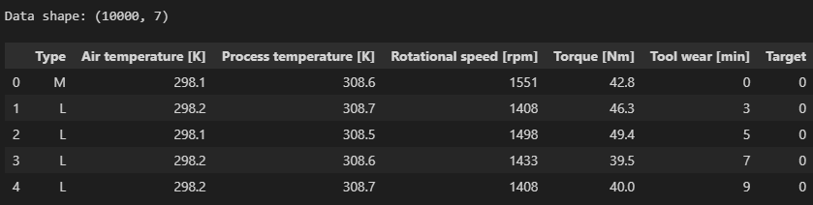
Machine learning pipeline
Evaluate data
shape and sample of data:

Slide 22
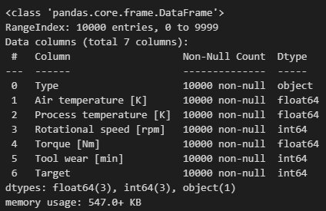
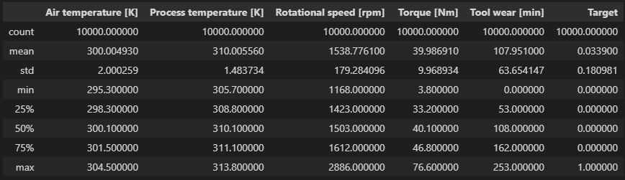
Machine learning pipeline
Evaluate data
Information about data:
Basic statistic:

Slide 23
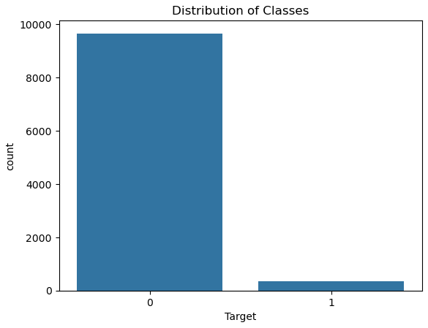
Machine learning pipeline
Evaluate data
Distribution of target:

Slide 24
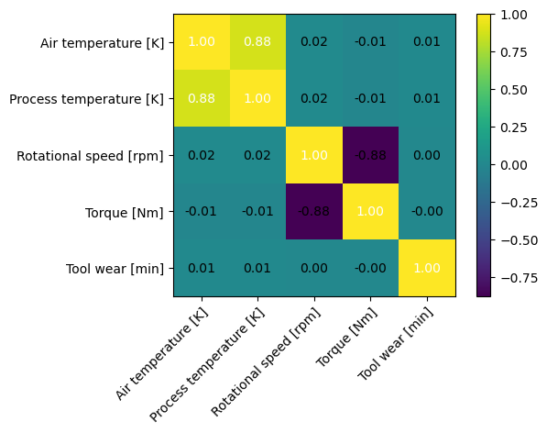
Machine learning pipeline
Evaluate data
Correlation between features:

Slide 25
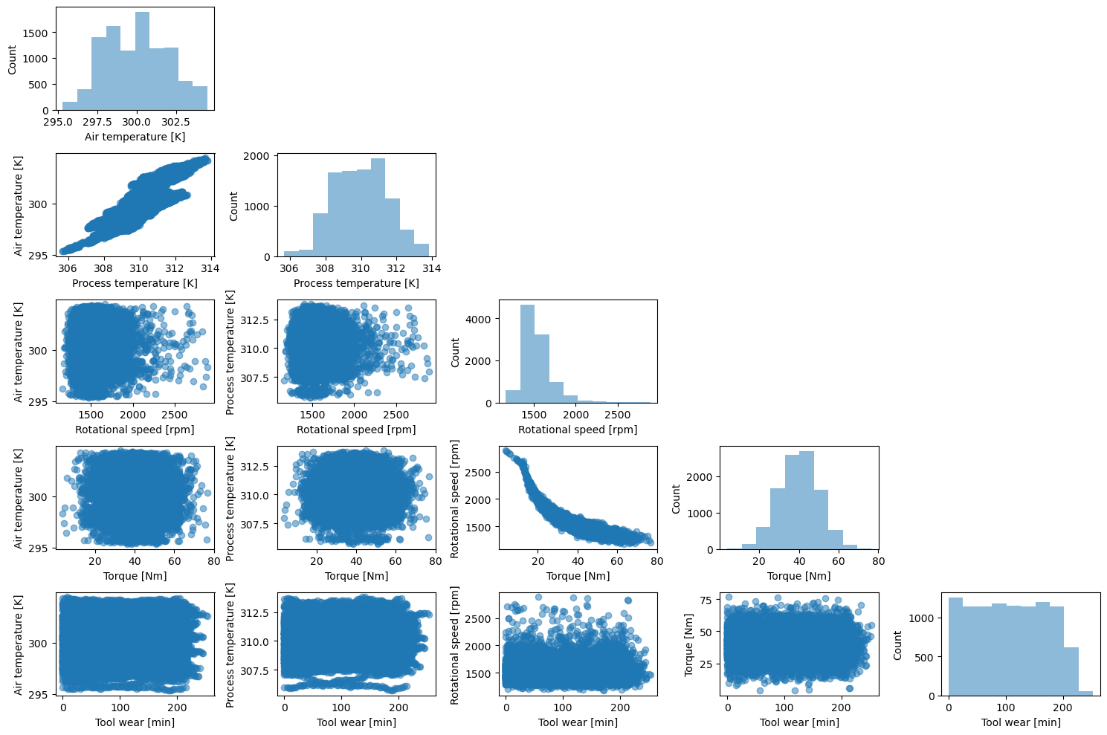
Machine learning pipeline
Evaluate data
Scatter plot matrix:

Slide 26
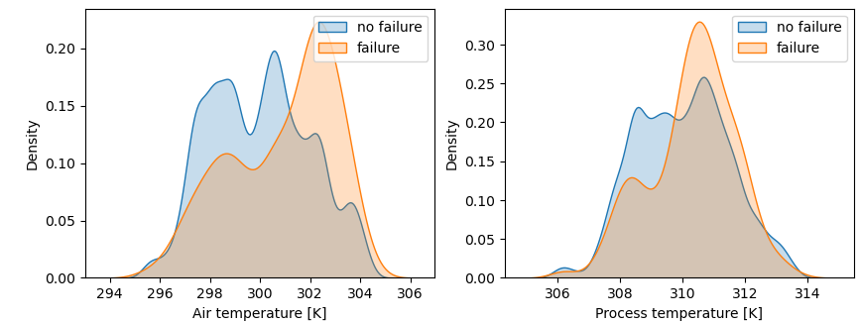
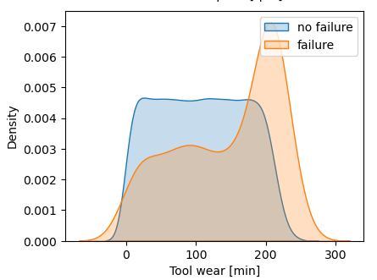
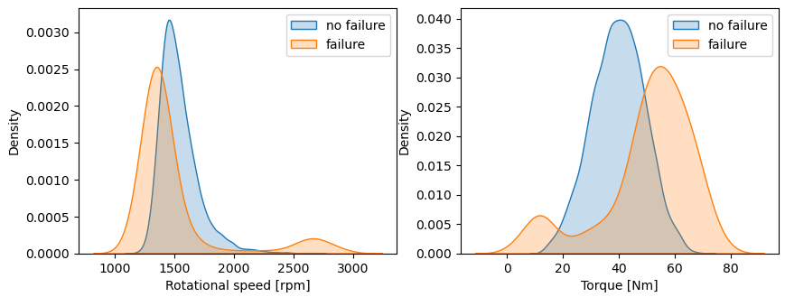
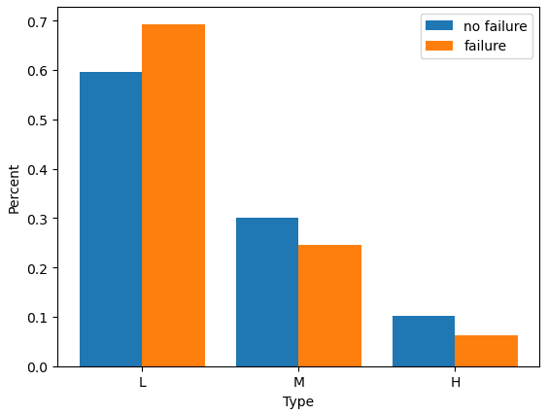
Machine learning pipeline
Evaluate data
Features influence on target:

Slide 27
Machine learning pipeline
New data or re-training
Model deployment
Business Problem
Formulate problem
Tune model
Yes
Collect and label data
Evaluate data
Perform feature engineering
Select and train model
Evaluate model
Meet business goal
Feature augmentation
No
Data augmentation

Slide 28
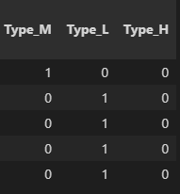
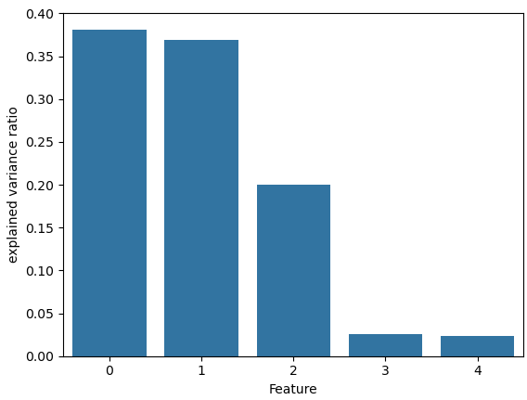
Machine learning pipeline
Perform feature engineering
Encoding non-numerical values:
Perform PCA to continuous features:

Slide 29
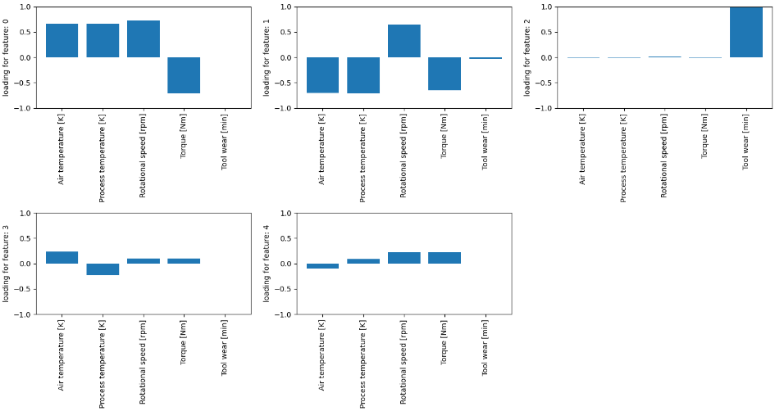
Machine learning pipeline
Perform feature engineering
Examining feature loading:

Slide 30

Machine learning pipeline
Perform feature engineering
Create new features Based on:
Feature loading on PCA components
Domain knowledge

Slide 31
Machine learning pipeline
New data or re-training
Model deployment
Business Problem
Formulate problem
Tune model
Yes
Collect and label data
Evaluate data
Perform feature engineering
Select and train model
Evaluate model
Meet business goal
Feature augmentation
No
Data augmentation

Slide 32
Machine learning pipeline
Select and train model
Tune model
Evaluate model
Models tested:
Logistic Regression
Linear SVM
Non-linear SVM
Random forest
XGBoost
Over sampling techniques tested:
SMOTE over sampler
Random over sampler

Slide 33
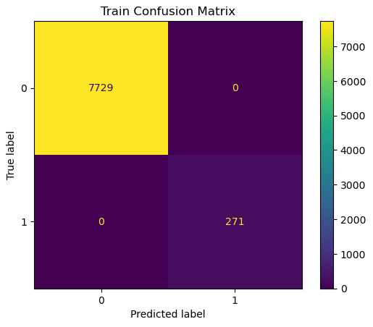

Machine learning pipeline
Select and train model
Tune model
Evaluate model
Best performing model is XGBoost with random over sampling:

Slide 34
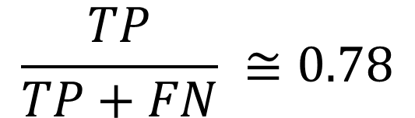
Machine learning pipeline
Select and train model
Tune model
Evaluate model
Best performing model is XGBoost with random over sampling:
Recall:
$$\frac{TP}{TP+FN} ≅0.78$$

Slide 35
Machine learning pipeline
New data or re-training
Model deployment
Business Problem
Formulate problem
Tune model
Yes
Collect and label data
Evaluate data
Perform feature engineering
Select and train model
Evaluate model
Meet business goal
Feature augmentation
No
Data augmentation

Slide 36
Machine learning pipeline
New data or re-training
Model deployment
Business Problem
Formulate problem
Tune model
Yes
Collect and label data
Evaluate data
Perform feature engineering
Select and train model
Evaluate model
Meet business goal
Feature augmentation
No
Data augmentation

Slide 37










Machine learning pipeline
Model deployment
Main architecture:
Additional services:

Slide 38

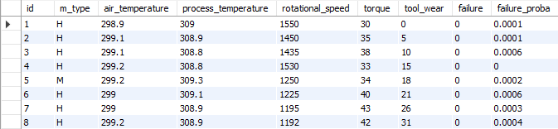
Machine learning pipeline
Model deployment
Amazon relational database (RDS) with two tables:
Sensors table (receive and store sensor data)
Predictions table (receives and store model predictions)

Slide 39
Machine learning pipeline
Model deployment
Main architecture:
Additional services:

Slide 40
Machine learning pipeline
Model deployment
Amazon event bridge:
Set up a scheduled event that sends an event triggers lambda function every fixed timestamp
Amazon elastic container registry (ECR):
Store all the following in a container repo inside AWS:
The code.
Trained model
All dependencies

Slide 41
Machine learning pipeline
Model deployment
Main architecture:
Additional services:

Slide 42
Machine learning pipeline
Model deployment
Amazon lambda:
Runs the container stored in ECR which do the following:
Retrieves last sensor reading from RDS
Makes prediction on it
Append model prediction to RDS
Activate an event that sends notification when machine failure is predicted
The code must be containerized along with its dependencies because it exceeds 200 MB which is lambda limit

Slide 43
Machine learning pipeline
Model deployment
Main architecture:
Additional services:

Slide 44
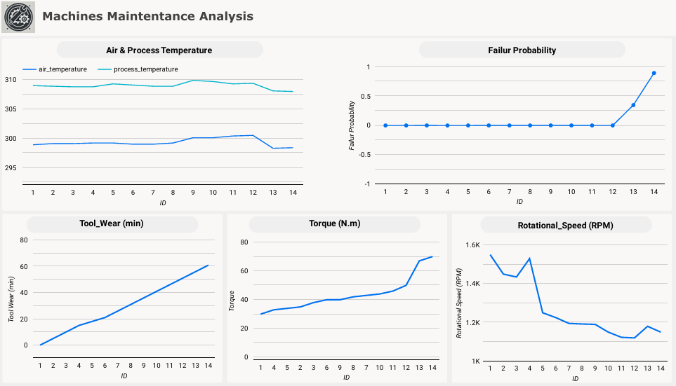
Machine learning pipeline
Model deployment
Amazon quicksight:
Visualize sensor reading and model prediction on a simple dashboard to enhance monitoring processes

Slide 45
Machine learning pipeline
Model deployment
Main architecture:
Additional services:

Slide 46
Machine learning pipeline
Model deployment
Amazon simple notification services (SNS):
Sends a message to subscribers when activated
Amazon event bridge:
Send an event that activates (SNS) topic
Amazon identity and access management:
Manages user creation and access to resources
Helped team members to collaborate on building the architicture

Slide 47
Machine learning pipeline
Model deployment
Main architecture:
Additional services:

Slide 48
Machine learning pipeline
Model deployment
Amazon budgets
Sends a budget notification when we exceed determined budget
Amazon sagemaker
Can use notebook instance to do all machine learning pipeline
Amazon simple storage service (S3)
Can be used to store the data used and the model developed

Slide 49
Machine learning pipeline
New data or re-training
Model deployment
Business Problem
Formulate problem
Tune model
Yes
Collect and label data
Evaluate data
Perform feature engineering
Select and train model
Evaluate model
Meet business goal
Feature augmentation
No
Data augmentation

Slide 50
Problem Statement
AGENDA
Machine learning pipeline
Well-architected framework

Slide 51
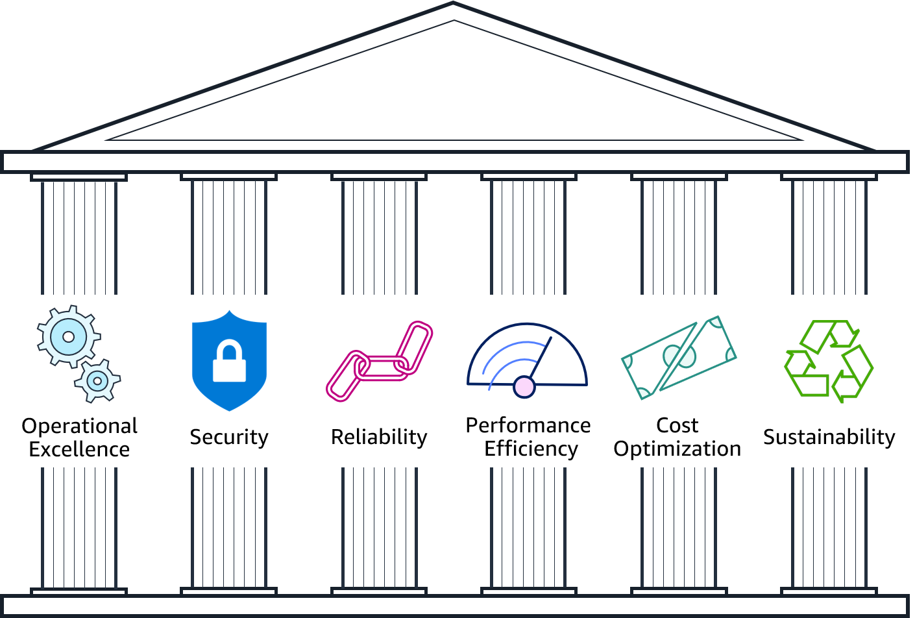
Well-architected framework

Slide 52
Well-architected framework
The architecture is built in single small steps to make sure everything works well
Every user had only necessary privilege to do his job
Secured RDS instance allowed only access from certain IPs

Slide 53
Well-architected framework
The architecture has fixed capacity that will never change with time
No matter if the data is lost
Considered serverless services and managed service
Tested the capacity first

Slide 54
Well-architected framework
Used only necessary services
Used needed capacity only
Calculated estimated cost of the project before implementation (cost calculator)
AWS provide sustainable resources (energy sources for their physical infrastructure)
The usage of serverless services also saves energy

Slide 55
Problem Statement
AGENDA
Machine learning pipeline
Well-architected framework

Slide 56
Problem Statement
Any Questions
Machine learning pipeline
Well-architected framework

Slide 57
Thank You For Attention!!!

